Slide 1
Welcome to My Presentation

Slide 2
My Presentation Topic is Class Object Interface
Presented By:
Name : Tushar Sarkar
Student ID: 18CSE035
Second Year First Semester
Department of CSE,BSMRSTU,
Gopalganj-8100.

Slide 3
What is an Classes and Objects?
Classes and objects are the two main aspects of object-oriented programming.
Class | Objects
Fruit | Orange Apple Mango

Slide 4
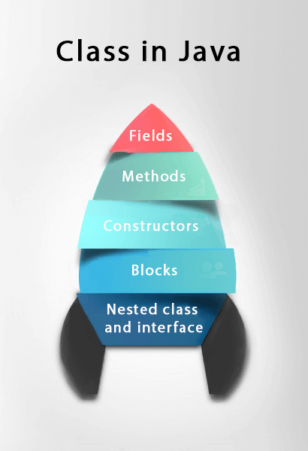
What is a class in java
A class is a group of objects which have common properties.
It is a template or blueprint from which objects are created.
It is a logical entity. It can't be physical.
A class in Java can contain:
Fields
Methods
Constructors
Blocks
Nested class and interface

Slide 5
Syntax to declare a class:
class <class_name>{
field;
method;
}
Method in Java is like a function which is used to expose the behavior of an object.
Advantage of Method
Code Reusability
Code Optimization

Slide 6
Create a Class
Main.java
public class Main {
int x = 5;
}
Create a class named "Main" with a variable x.

Slide 7
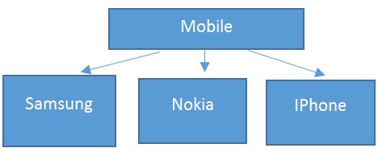
Real world examples of objects

Slide 8
Characteristics of Object
An object has three characteristics:
State: represents the data (value) of an object.
Behavior: represents the behavior (functionality) of an object such as deposit, withdraw, etc.
Identity: An object identity is typically implemented via a unique ID. The value of the ID is not visible to the external user. However, it is used internally by the JVM to identify each object uniquely.

Slide 9
Object definitions
An object is an instance of a class.
A class is a template or blueprint from which objects are created.
So, an object is the instance(result) of a class.

Slide 10
Create an Object
public class Main{
public static void main(String[] args) {
value f = new Value(); //create an Value object
System.out.println(f.x);
}
}
class Value{
int x = 10;
}

Slide 11
Interface in Java
An interface in Java is a blueprint of a class.
It has static constants and abstract methods.
There are mainly three reasons to use interface
It is used to achieve abstraction.
By interface, we can support the functionality of multiple inheritance.
It can be used to achieve loose coupling.

Slide 12
How to declare an interface?
Syntax:
interface <interface_name>{
// declare constant fields
// declare methods that abstract
// by default.
}

Slide 13
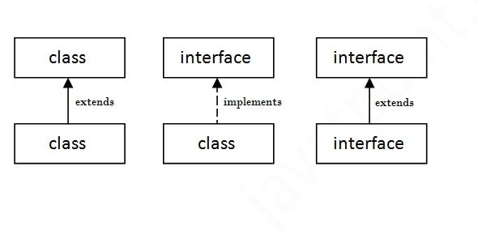
The relationship between classes and interfaces

Slide 14
Simple code for interface
public class A {
public static void main(String[] args) {
demo f = new demo();
f.print();
}
}
interface printable {
void print();
}
class demo implements printable {
public void print() {
System.out.println("Hello");
}
}

Slide 15
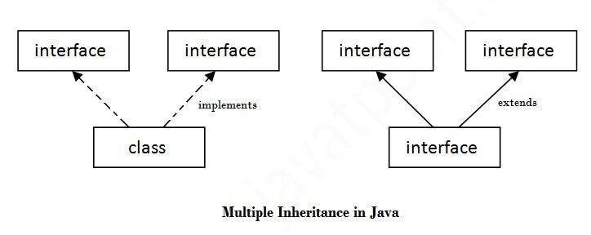
Multiple inheritance in Java by interface

Slide 16
Multiple inheritance Code
public class A{
public static void main(String[] args) {
demo f = new demo();
f.print();
f.show();
}
}
interface printable{ void print();} //1st interface
interface showable{ void show();} // 2nd interface
class demo implements printable, showable {
public void print() {
System.out.println("Hello");
}
public void show(){
System.out.println("Welcome");
}
}

Slide 17
Interface inheritance
A class implements an interface, but one interface extends another interface.
General code: interface printable{ void print();} interface showable{ void show();} class demo implements showable,printable { public void print() { System.out.println("Hello"); } public void show(){ System.out.println("Welcome"); } } | Interface extend another interface interface printable{ void print();} interface showable extends printable{ void show();} class demo implements showable { public void print() { System.out.println("Hello"); } public void show(){ System.out.println("Welcome"); } }

Slide 18
Thank you

